Slide 1



Branded Search Analysis
x
Placeholder

Slide 2

Relevant Branded
search terms
Branded Search
Performance
Branded Search
Above the Fold
AGENDA
Branded Search
Below the Fold
GMB Section
People Also Ask

Slide 3
What is Branded Search?
A branded keyword, or a branded search, is a search that includes the name of your company, business or brand, or an entity closely aligned with the brand of your company.

Slide 4
Why Does Branded Search Matter?
When someone searches for your brand, what do they find?
Branded search queries are used by people who already know your brand, or are at the very least familiar and are actively seeking information or an offering from your brand.
Those searching your brand name directly are more likely to convert into customers.
Branded results say a lot about your company, services, and products. Branded results can either encourage or deter searches from purchasing from you.

Slide 5
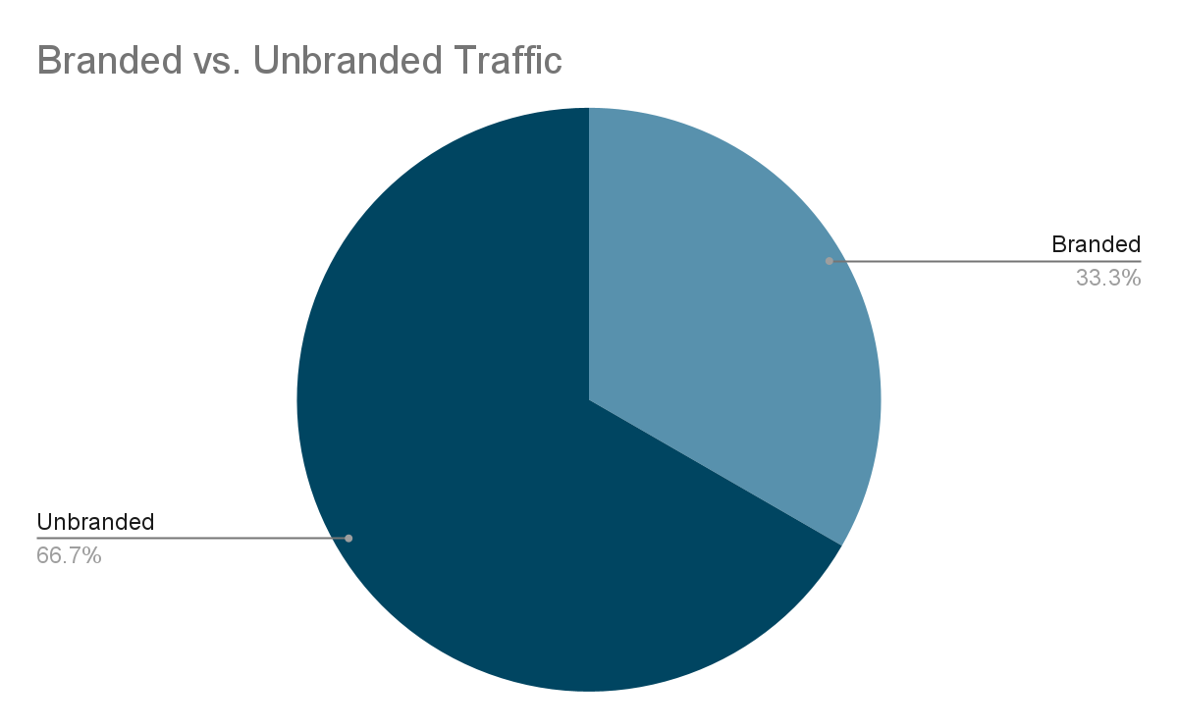
Your Traffic Breakdown

Slide 6
Your Branded Search Terms
BRANDED SEARCH TERM | SEARCH VOLUME
grand european travel | 1600
grand european tours | 300
get tours | 400
getours | 200
grand european travel reviews | 90
getours reviews | 40
get tours reviews | 40
get tours 2022 | 30
ge tours | 30
grand european tours reviews | 10
BRANDED SEARCH TERM | SEARCH VOLUME
grand european travel | 1600
grand european tours= | 300
get tours | 400
getours | 200
grand european travel reviews | 90
getours reviews | 40
get tours reviews | 40
get tours 2022 | 30
ge tours | 30
grand european tours reviews | 10

Slide 7
Competitive Brand Search Volume Comparison
{Client Website} | {Competitor 1} | {Competitor 2} | {Competitor 3} | {Competitor 4}
1600/month | 1600/month | 1600/month | 1600/month | 1600/month

Slide 8


Branded Search Example

Slide 9
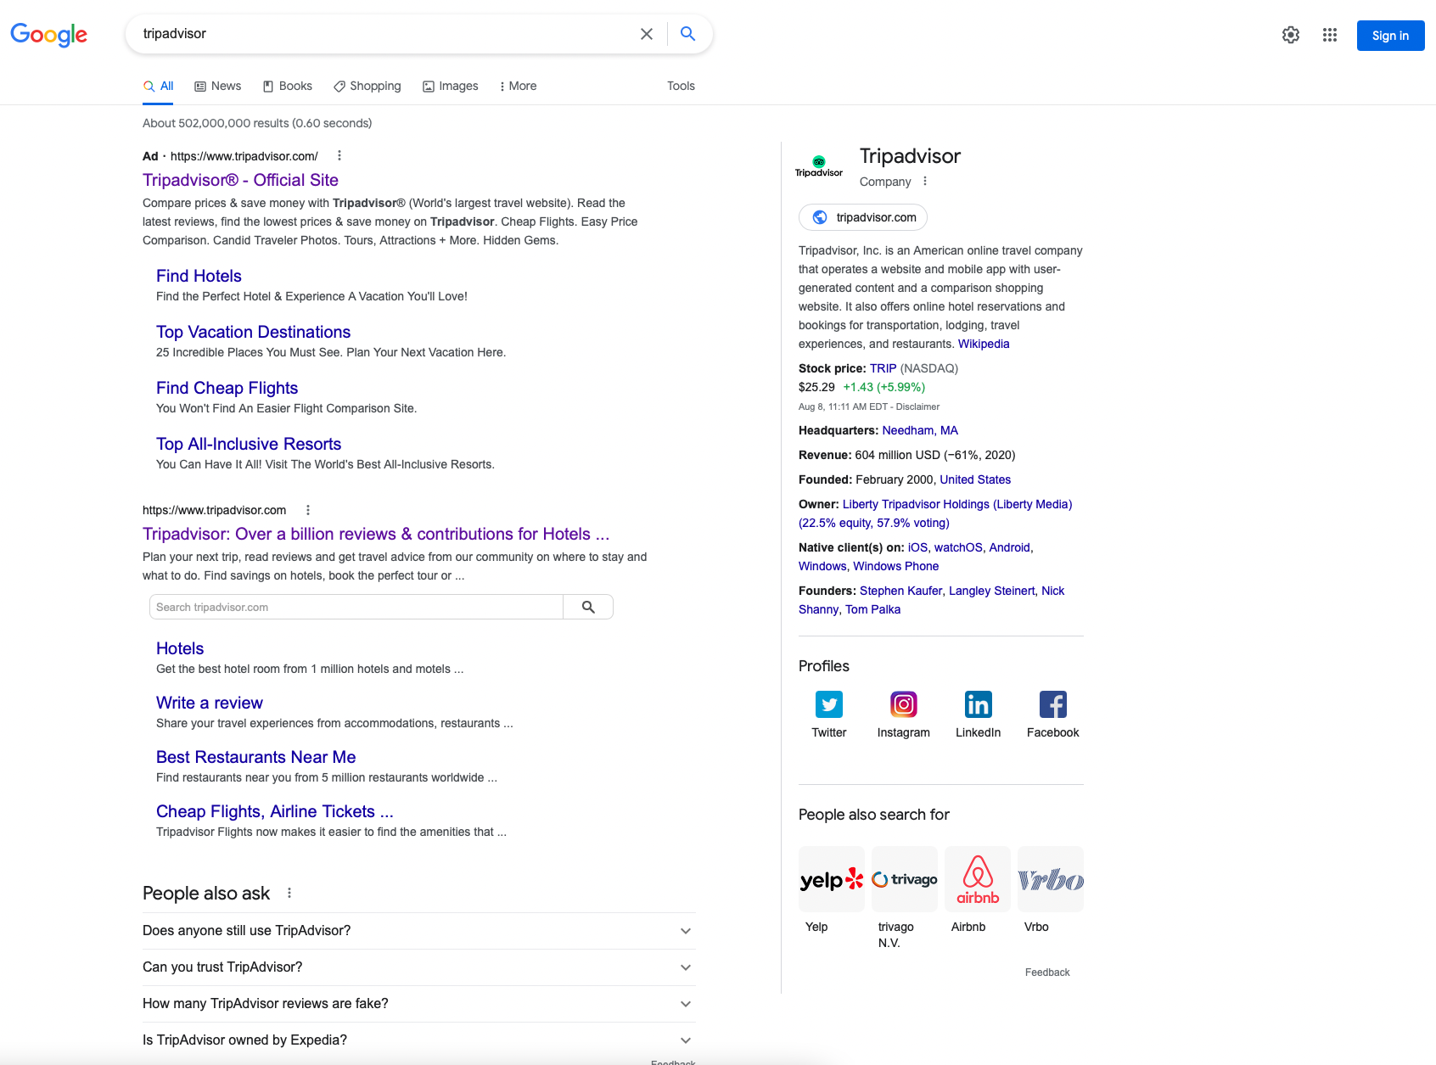
Example: Branded Search Results
1 - Branded Advertisement
2 - Branded Organic Result With Search & Sitelinks
3 - People Also Ask
4 - Knowledge Panel
1
4
2
3

Slide 10
Knowledge Panel

Slide 11
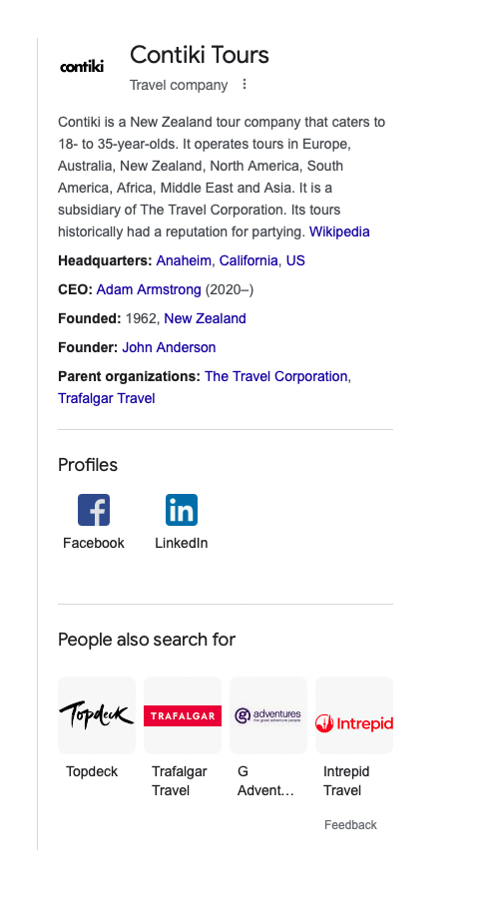
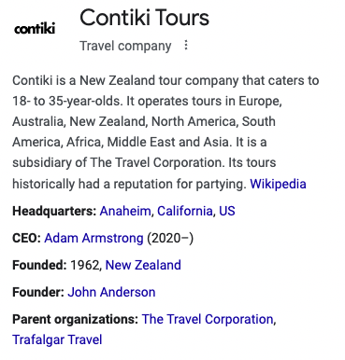
Contiki’s Knowledge Panel
✔
✔
✔
✔
✔
X
X
✔
X
✔

Slide 12
Missing Knowledge Graph Features
Stock Symbol
Sales Phone Number
Founding Date
Foundres
Products

Slide 13
Local Result

Slide 14
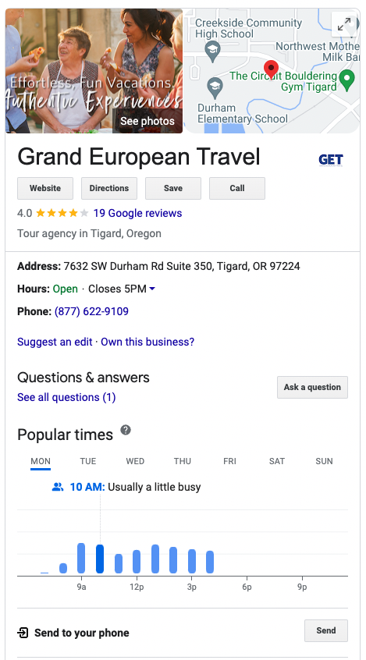
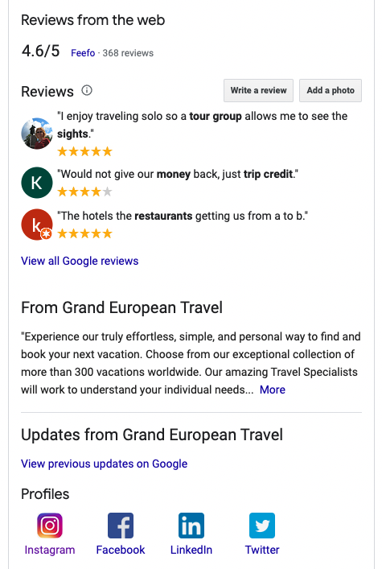
GET’s Knowledge Panel
Solicit positive reviews
Add correct hours
Add phone number
Add photos
✔
✔
✔

Slide 15
Structured Data

Slide 16
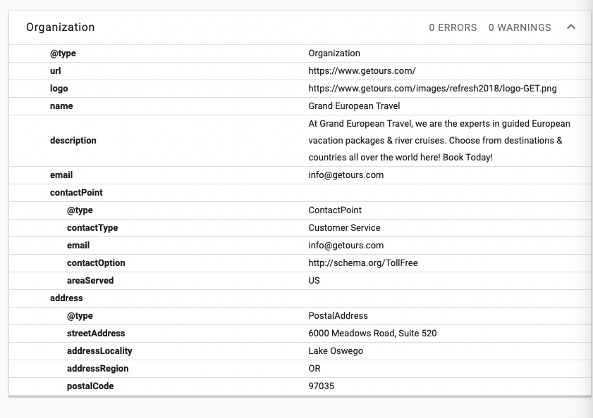
Current Markup Usage

Slide 17
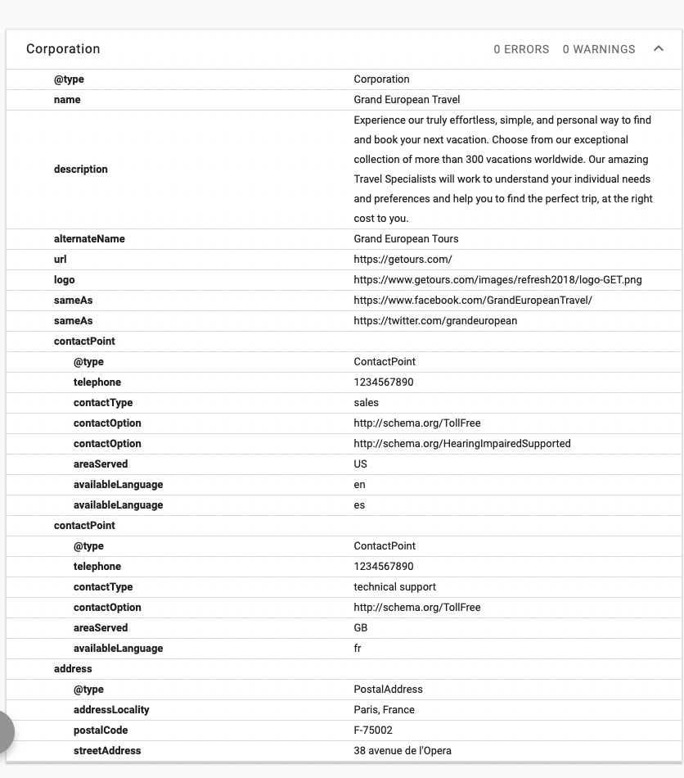
Suggested Markup Usage
Change to Corporation
Add Address
Add Contact Points
Add Social Profiles
Remove XYZ

Slide 18
SERP Ownership

Slide 19

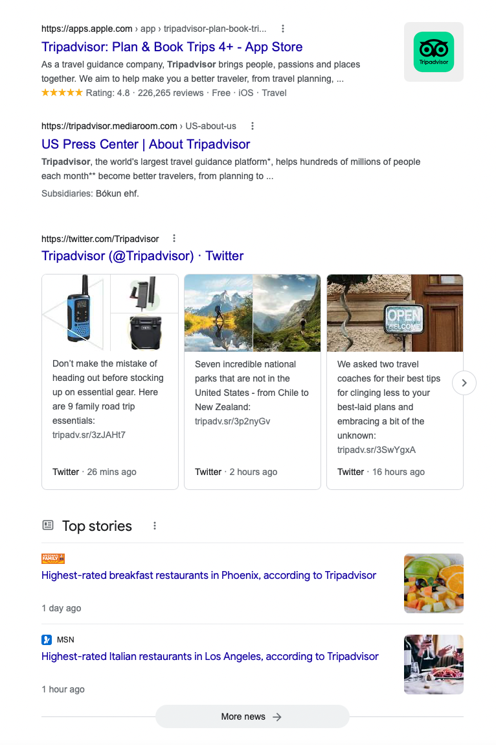
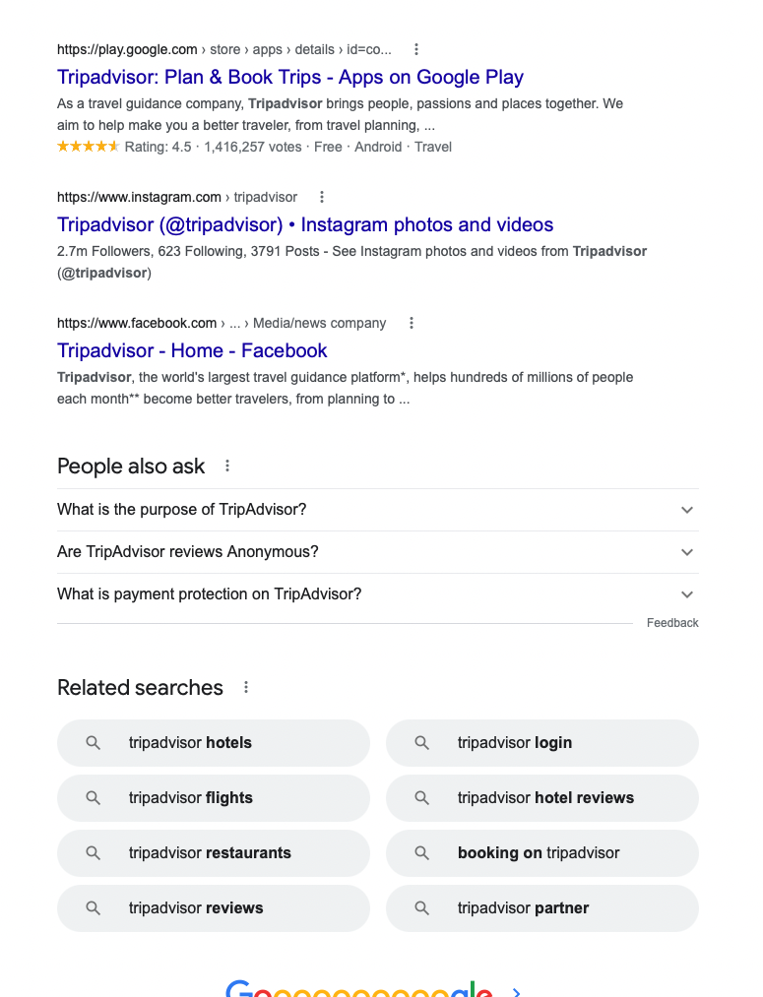
Owned vs. Unowned Properties on Page One

Slide 20

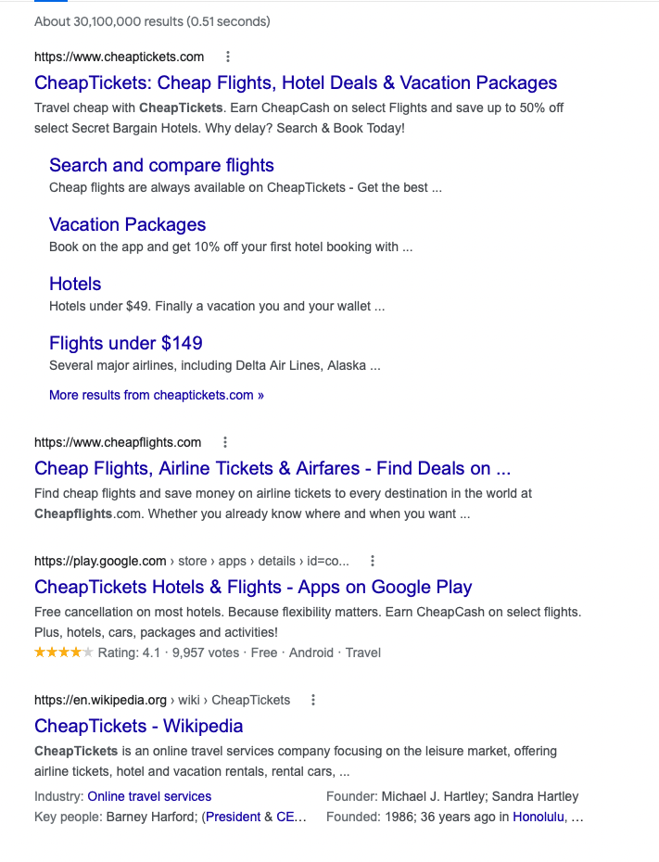
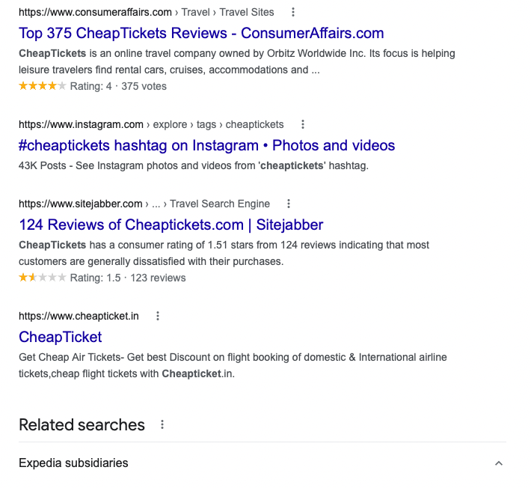
Owned vs. Unowned Properties on Page One

Slide 21
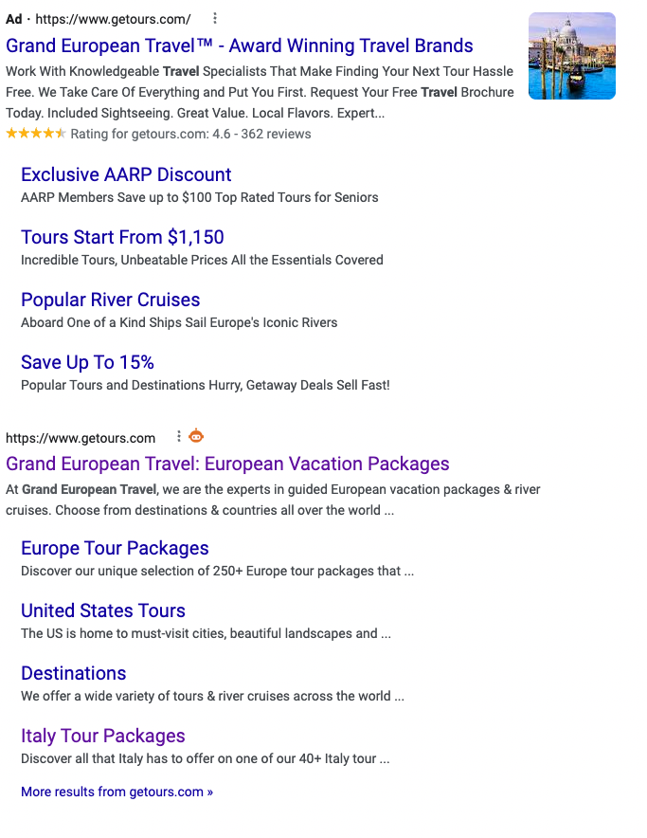
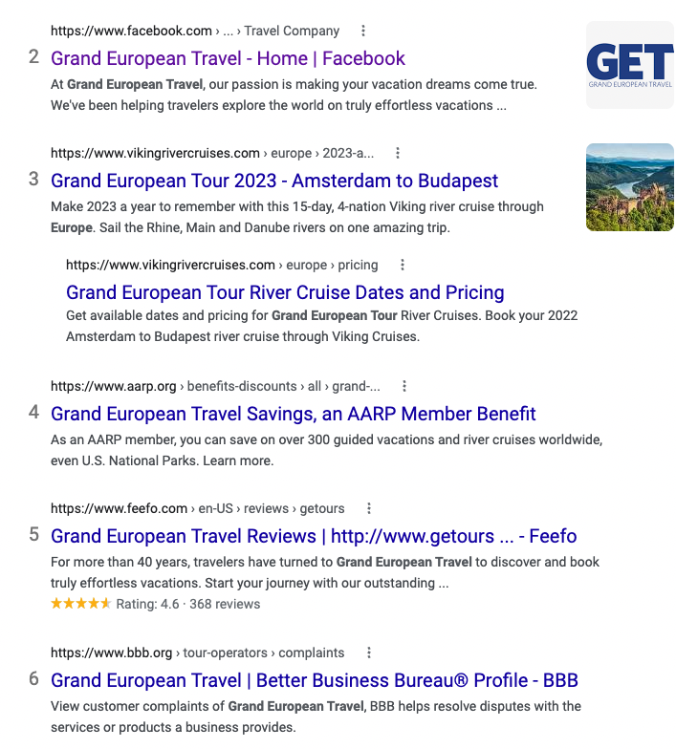
SERP Ownership Review

Slide 22
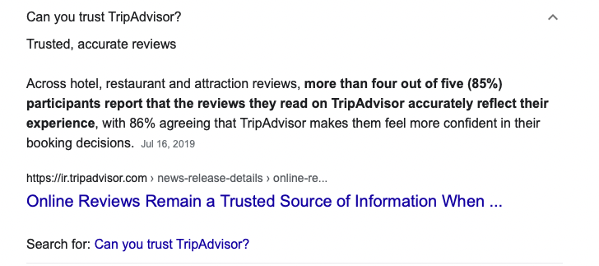
People Also Ask Ownership Example
In this example, a potentially damaging Q&A is owned by TripAdvisor’s web properties, allowing them to control the narrative.

Slide 23
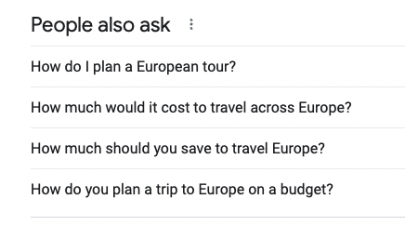
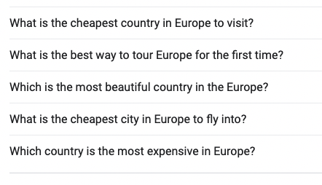
People Also Ask Ownership Review

Slide 24
SERP Ownership Recommendations
Create Page XYZ
Drive links to page XYZ
Remove link to BBB from Website
Answer People Also Ask Questions:
Question 1
Question 2
Question 3
Question 4

Slide 25
Your Web Properties

Slide 26
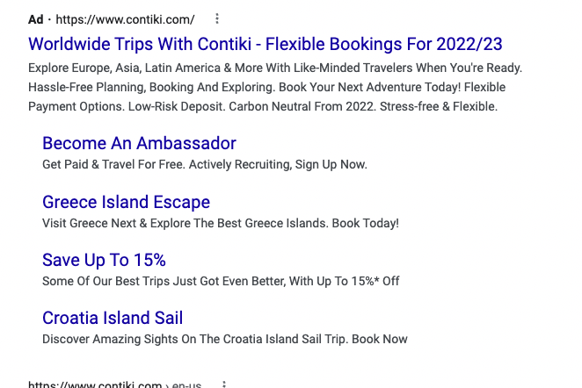
Paid Search Branded Result
Change to Corporation
Add Address
Add Contact Points
Add Social Profiles
Remove XYZ

Slide 27
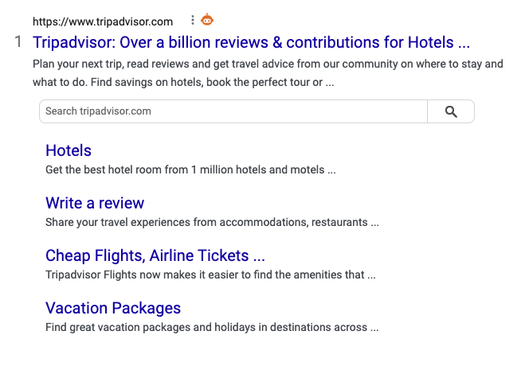
Organic Search Branded Result
Change to Corporation
Add Address
Add Contact Points
Add Social Profiles
Remove XYZ

Slide 28
Recommendation Summary
Create Page XYZ
Drive links to page XYZ
Remove link to BBB from Website
Answer People Also Ask Questions:
Question 1
Question 2
Question 3
Question 4

Slide 29
Thank You

